Slide 1

Java Speech Calculator
GOXR3PLUS STUDIO(2016-2017)

Slide 2
Technologies Used
Sphinx API 5
Mary TTS 5.2
Java + JavaFX(UI)

Slide 3
Overview
Java Speech Calculator is made in 3 parts:
Using Sphinx 4-5 (pre-alpha)application programming interface for speech recognition.
Using MaryTTS application programming interface for Text To Speech Analysis.
Using JavaFX for simple programming interface.

Slide 4
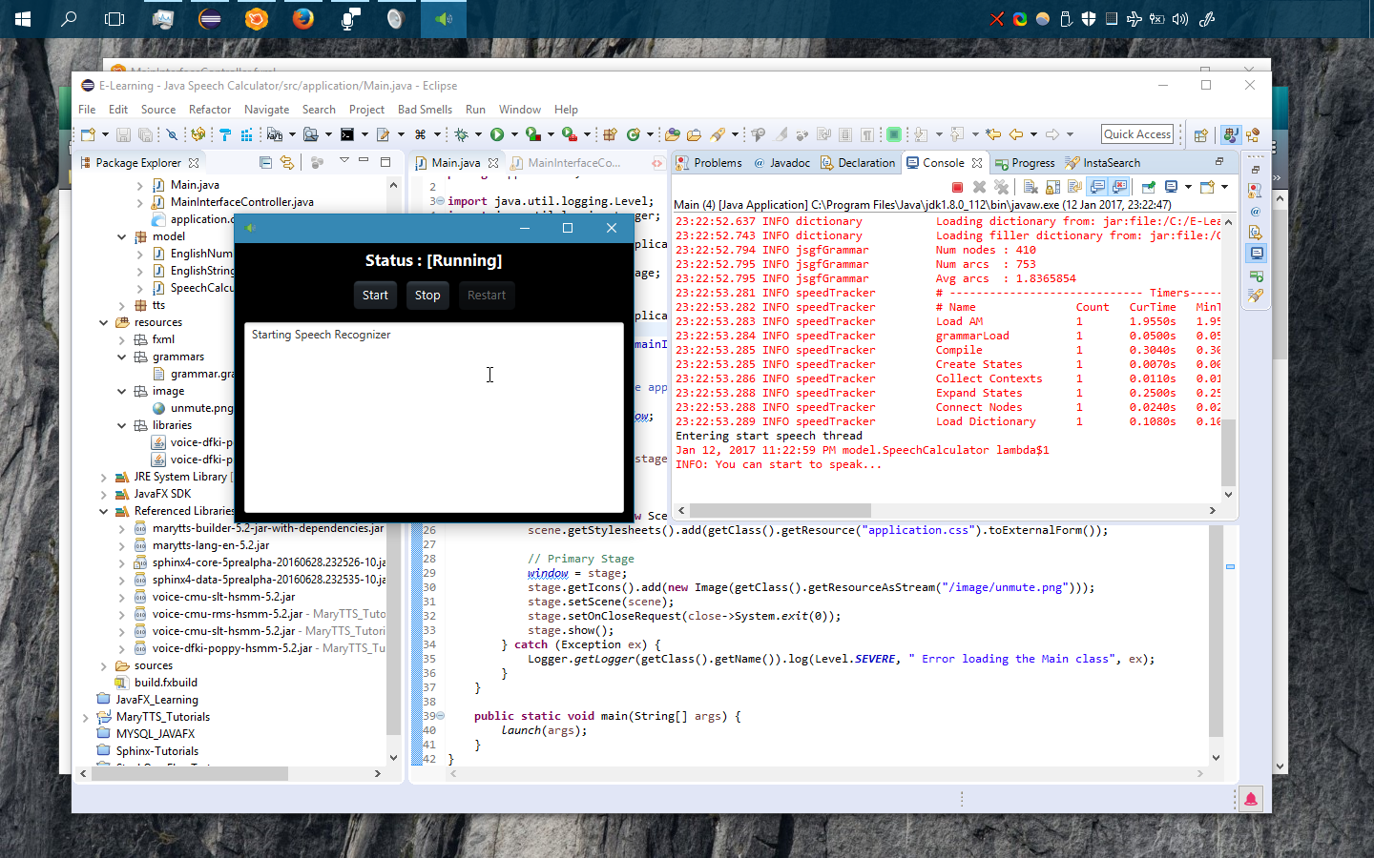
The Present Situation(Alpha-Prototype)

Slide 5
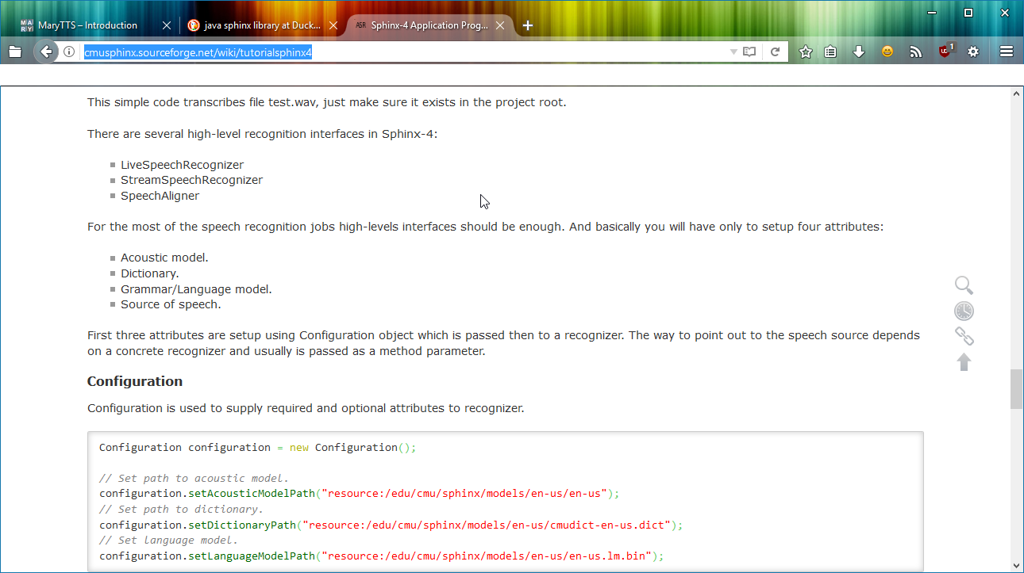
Sphinx 4-5

Slide 6
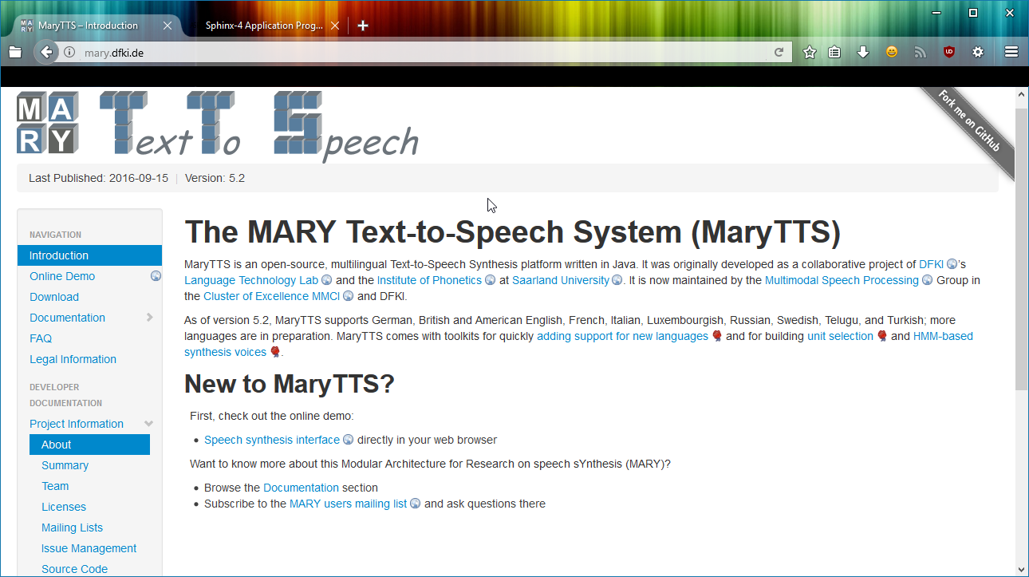
Mary TTS

Slide 7
Where I go after here?
Sphinx frequently asked questions:
http://cmusphinx.sourceforge.net/wiki/faq/
You can find online tutorials about how to use this tool and make your own like Jarvis System.
https://www.youtube.com/watch?v=E1rwKpAYM0Q

